Slide 1
Презентация на тему:
Volunteer work. Join us.
Выполнила учитель английского языка
МОБУ «Новочеркасская СОШ»
Абдрахманова Раниля Геннадьевна.

Slide 2
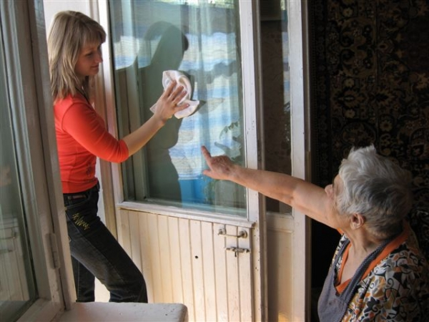
We help disabled senior citizens to wash dishes, clean the rooms, go shopping etc.

Slide 3
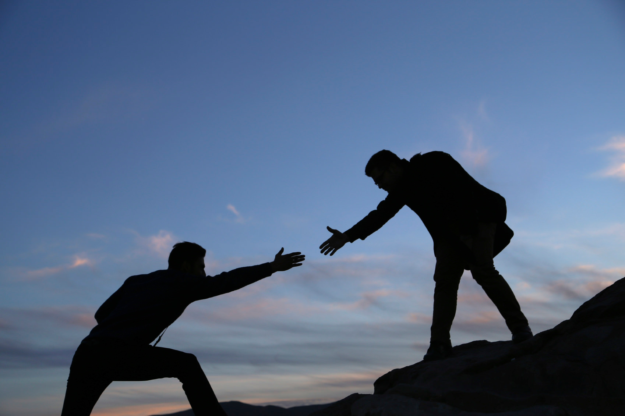
I think, it’s very good to help somebody

Slide 4
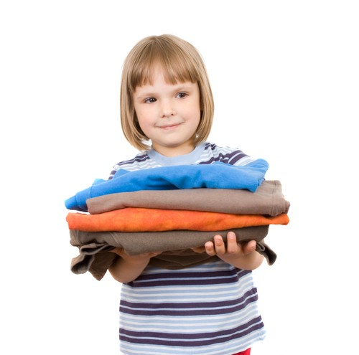
My family donates old clothes and books to the local charity shop

Slide 5
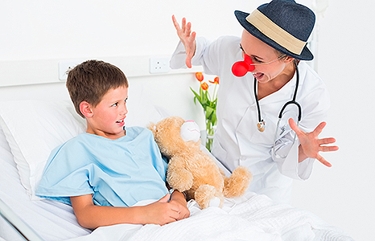
I volunteer once a week at a children's hospital.

Slide 6
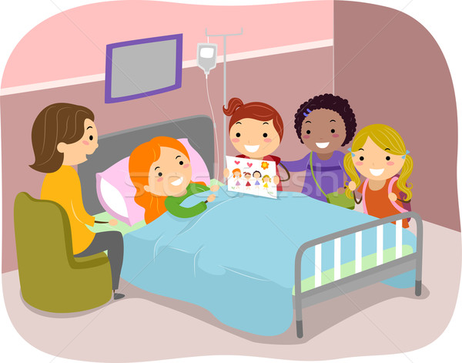
The fact that we came to see Lizzy in hospital after the accident really encouraged her.

Slide 7
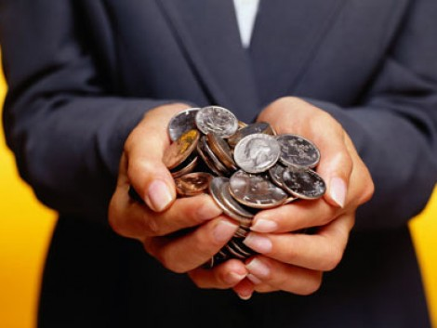
Many people support charities by giving money to them regularly

Slide 8
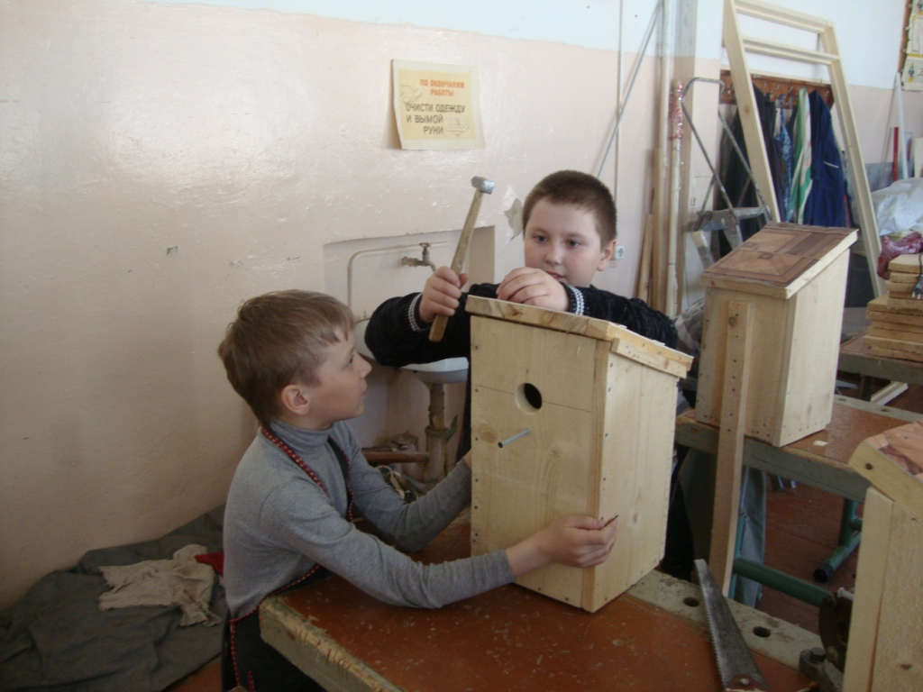
You can do it in your free time.
It won't take much time.

Slide 9
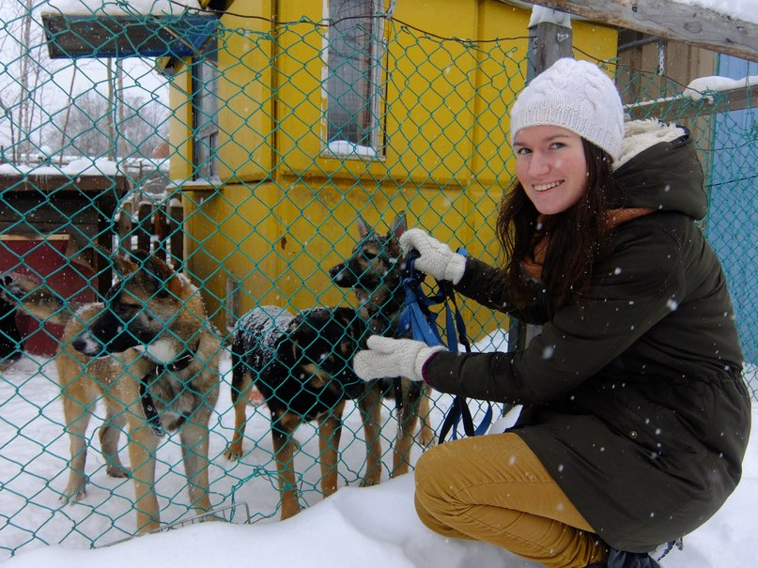
We work as a volunteer at the animal shelter. I think that it’s very hard, but interesting

Slide 10
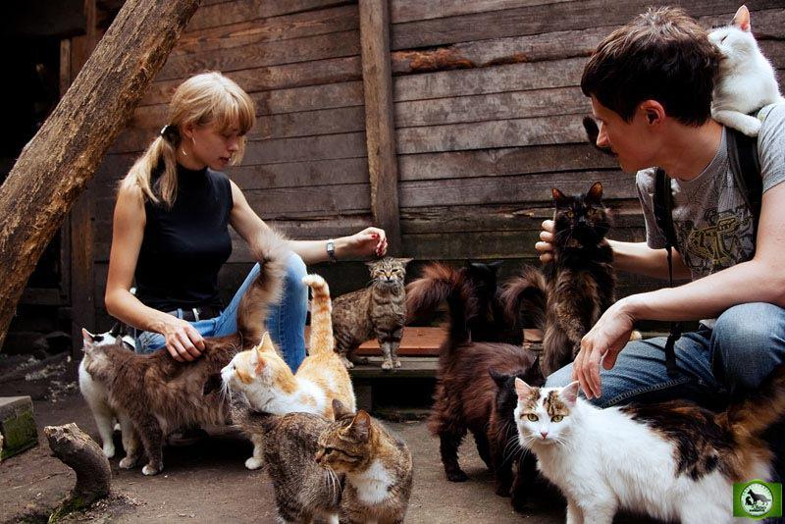
My friends and I educate animals, take care about them.

Slide 11
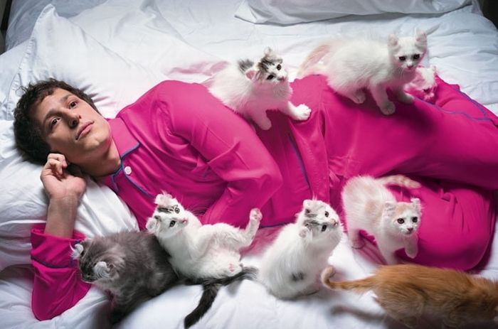
My uncle liked the idea of getting involved with the local animal shelter and their campaign.

Slide 12
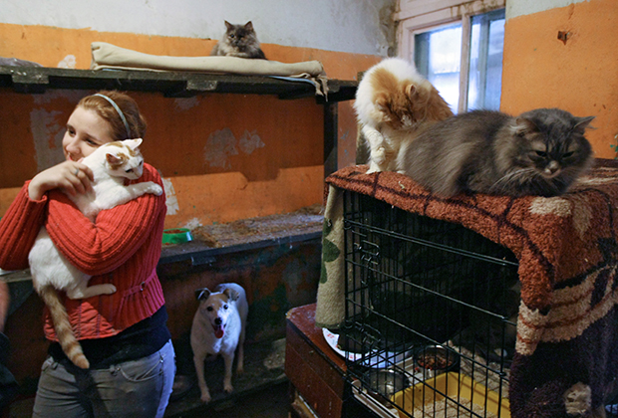
You will learn to care about animals

Slide 13
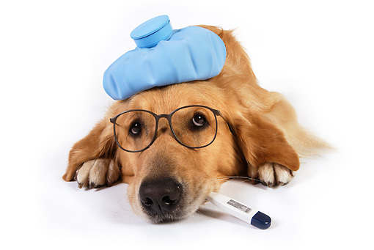
I’m very glad to help animals! I have taken home a sick puppy.

Slide 14
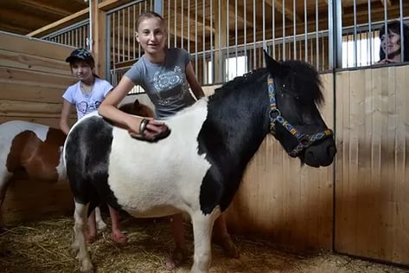
You will see many amazing animals and be able to care about them

Slide 15
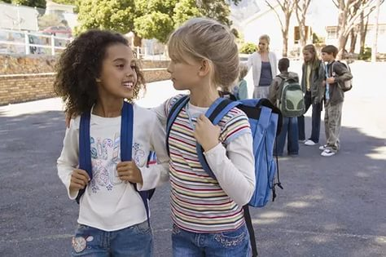
You can meet many volunteers of your age and make new friends

Slide 16
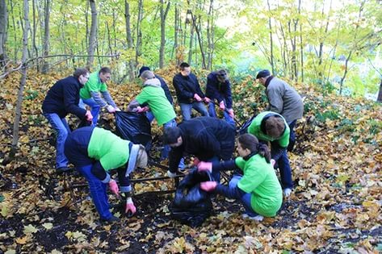
You can volunteer as often as you like

Slide 17
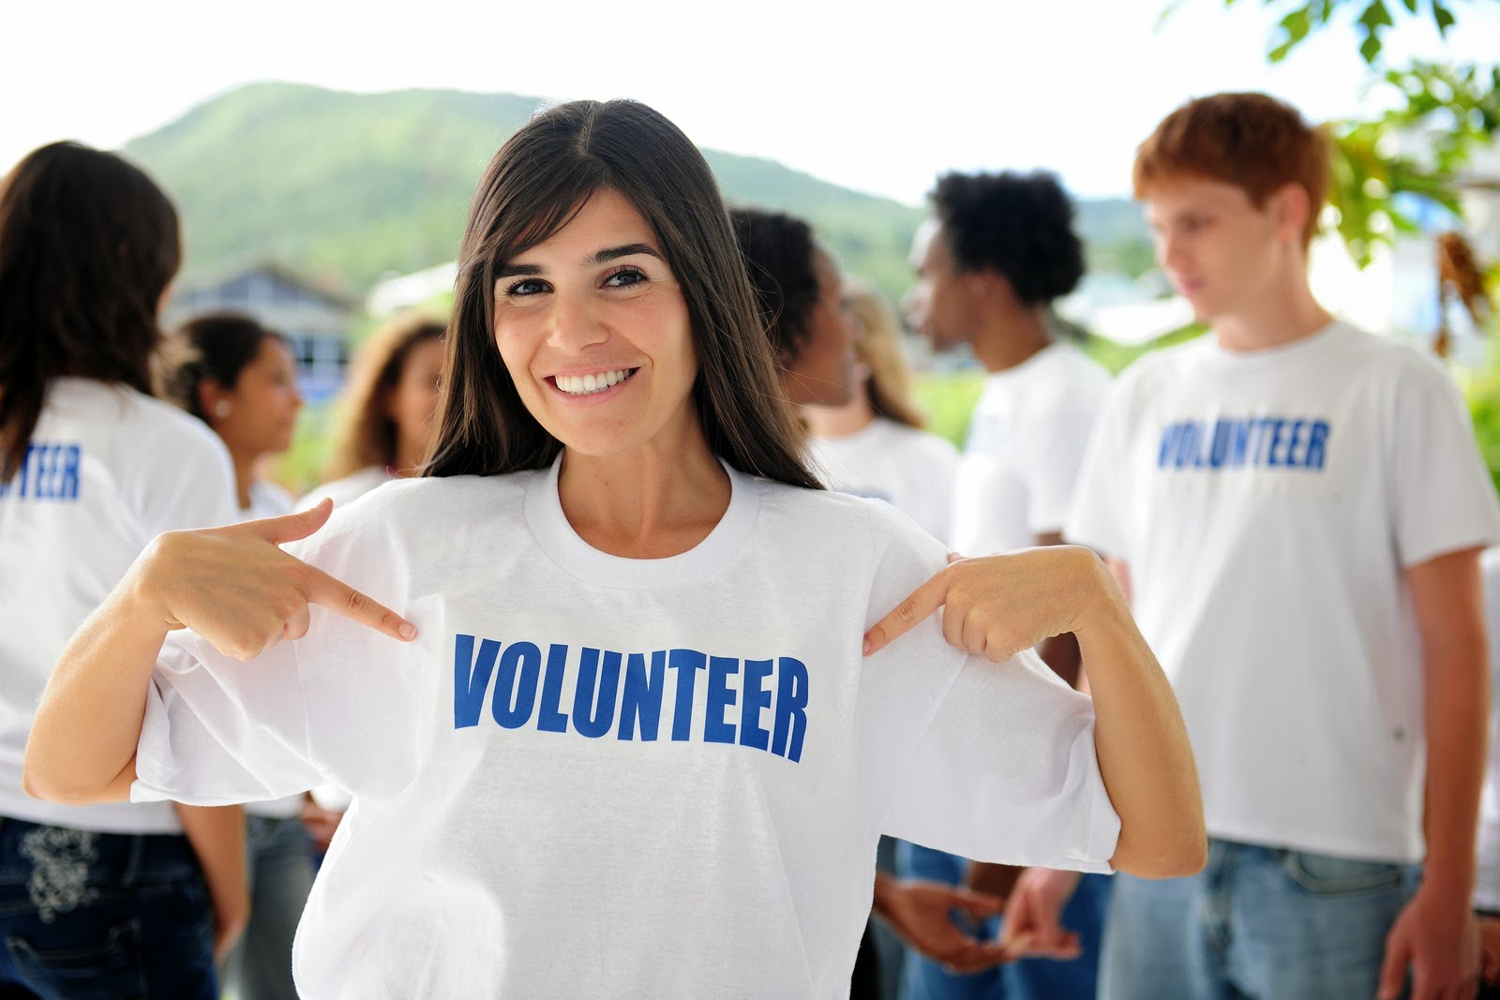
You should think about it.

